Slide 1
MACHINE LEARNING WITH LENDING LOAN CLUBS
PROJECT BY :
HEMAMALINI MADHANGURU
LAKSHMI SUNDARARAJAN
PALLAVI ATTIMAKULA

Slide 2
TABLE OF CONTENTS
Hardware Experimental Specifications
Dataset Information
Analyze Data
Data Trends
Removing Outliers
Machine Learning – Azure
Machine Learning – Spark
GitHub Link
Summary
References

Slide 3
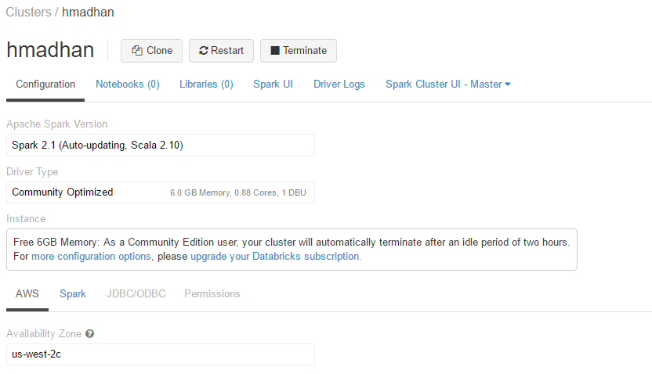
HARDWARE EXPERIMENTAL SPECIFICATIONS
File System – Data Bricks File System (DBFS)
Apache Spark Version – Spark 2.1 (Auto – updating, Scala 2.10)
Memory – 6GigaBytes

Slide 4
DATASET INFORMATION
Name – Lending Loan Clubs
Size – 240 MB
Format – CSV
Source – https://www.kaggle.com/wendykan/lending-club-loan-data
Years – 2013,2014

Slide 5
ANALYZE DATA
Our dataset recounts the ‘Loans issued by Lending Club’
This URL contains the entire data regarding peer to peer lending club loans including the current loan status (Current, Late, Fully Paid, etc.) and latest payment information
It includes information such as loan amount, term, interest rate, monthly installment amount, current loan status, purpose of loan, city, loan period, etc
Additional features include credit scores, number of finance inquiries, address including zip codes, and state. The file is a matrix of about 890 thousand observations and 75 variables.

Slide 6
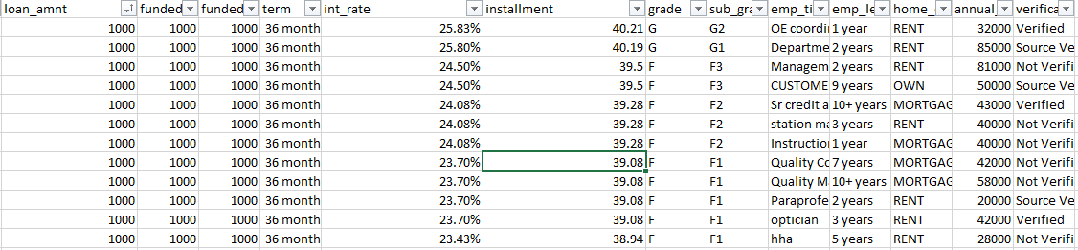
Overview of Dataset

Slide 7
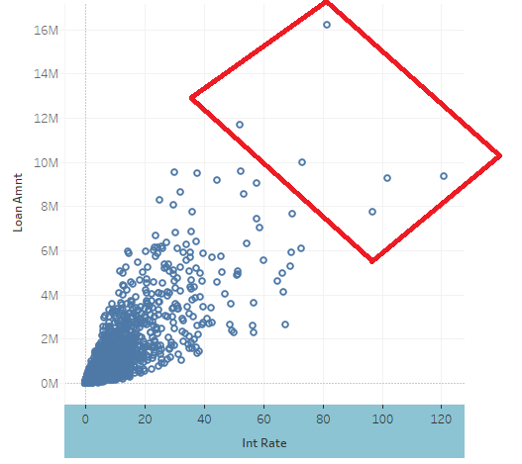
DATA Preprocessing
Loans with higher amounts → higher interest rate.
As seen from the scatter plot, few installments fall in the range of higher loans and lesser interest rates which are considered as outliers.

Slide 8
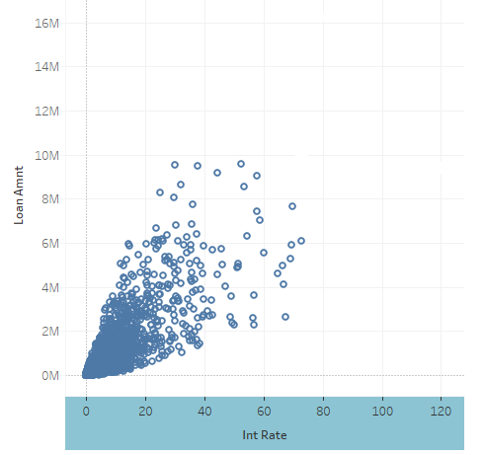
ReMOVING THE OUTLIERS
SQL QUERY:
Select avg(int_rate),avg(loan_amt),installment from loanStats3c where avg(int_rate)<80% and avg(loan_amt)<95,00000

Slide 9
AZURE ML - REGRESSION
Goal – To predict the installments based on the loan amount and interest rate
Algorithms used – Linear Regression , Decision Forest Regression
Features – Loan amount, interest Rate
Label – Installments
Range of values for installments
Min : 23.36 and Max :1409.99
Coefficient of Determination Accuracy: 90%

Slide 10
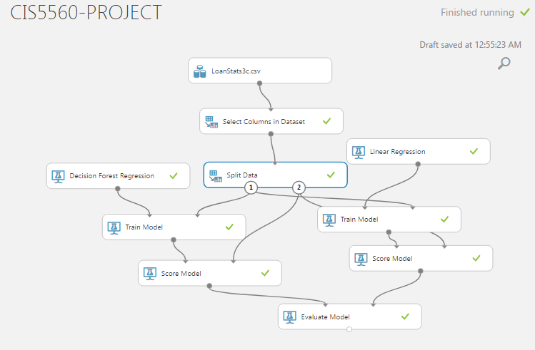
AZURE ML OVERVIEW

Slide 11
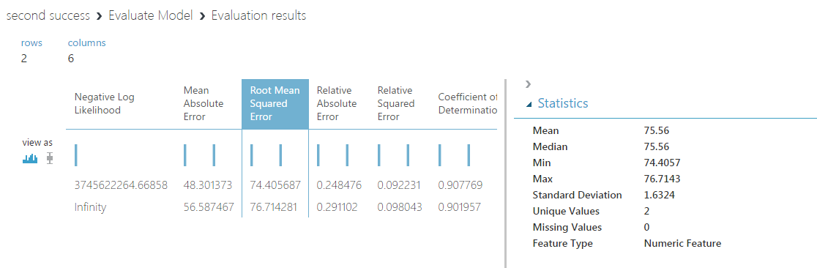
Azure Ml- Evaluation

Slide 12
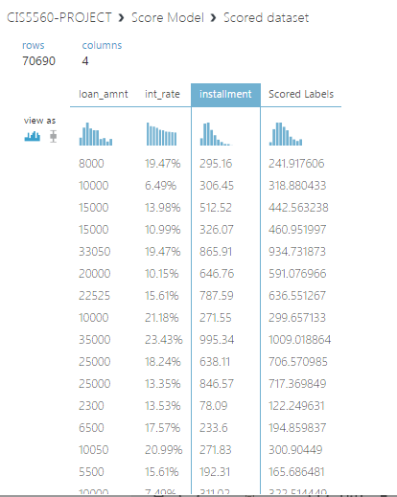
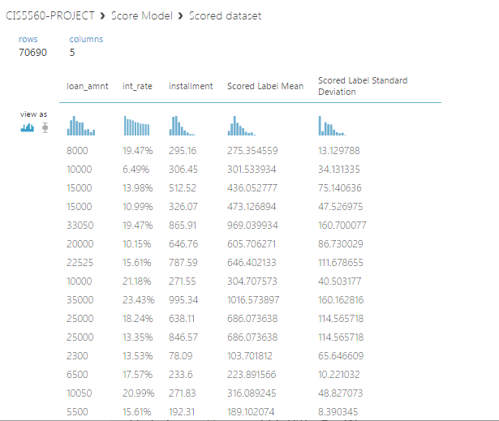
Score model : Linear Regression VS Decision tree Regression

Slide 13
AZURE ML - REGRESSION
Evaluation Metric – Root Mean Squared Error
01
Split Data – 70% for Train and 30% for Test
02
Accurate Model – Decision Forest Regression
03
RMSE – 74. 405
04

Slide 14
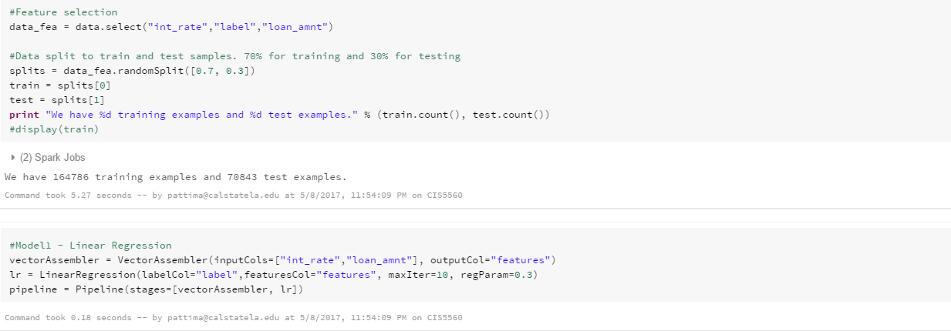
Spark ml- Overview of iPython Notebook in Databricks
Training, testing and evaluating the model with Train Validation Split

Slide 15
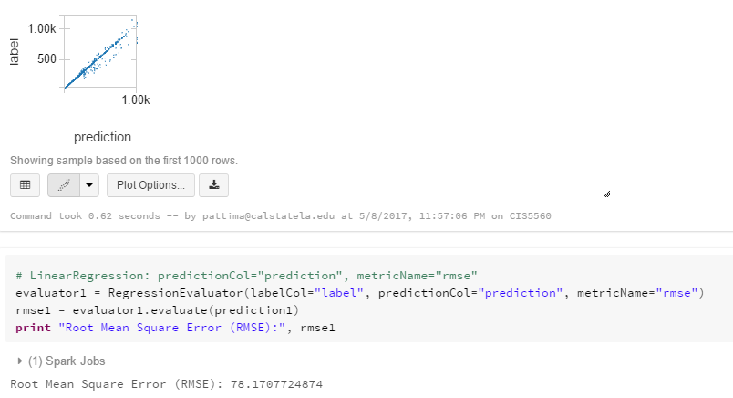
SPARK ML – Linear Regression

Slide 16
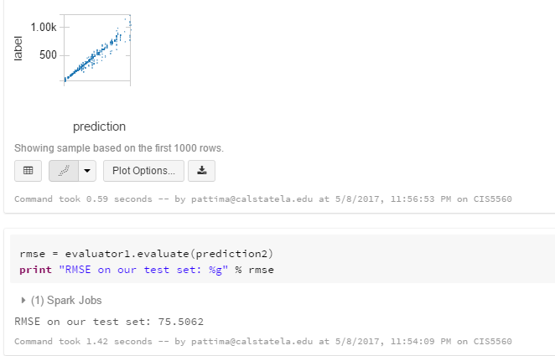
SPARK ML –Decision tree Regression

Slide 17
SPARK ML - REGRESSION
Evaluation Metric – Root Mean Squared Error
01
Split Data – 70% for Train and 30% for Test
02
Accurate Model – Decision Forest Regression
03
RMSE – 75.506
04

Slide 18
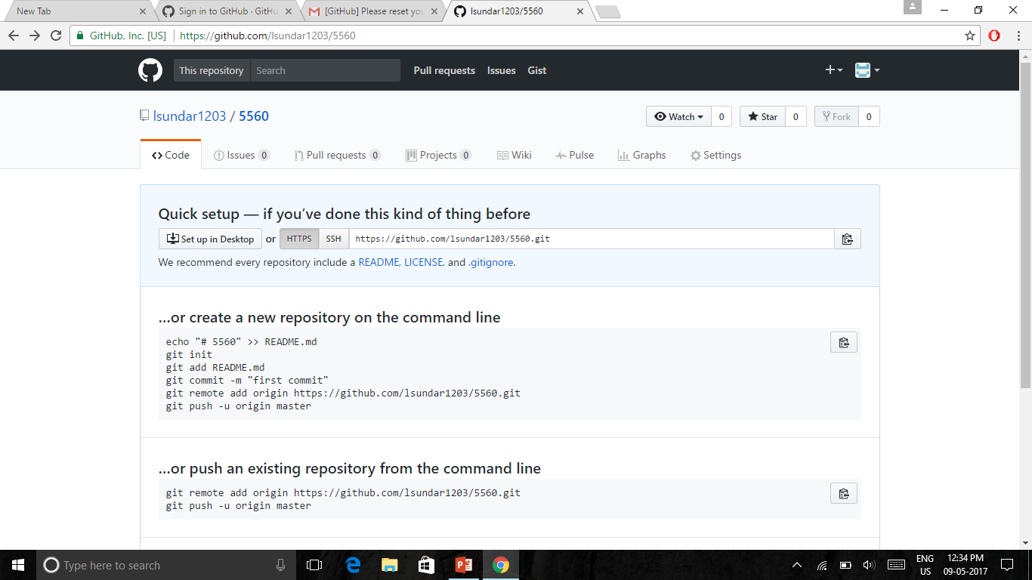
GITHUB LINK
https://github.com/lsundar1203

Slide 19
SUMMARY
We analysed the data with different algorithms in regression and in classification
In regression as discussed we tried to predict the installment rates whereas in classification we wanted to analyse the same with respect to home ownership
But since our dataset has continuous values we couldn’t perform classification
Amongst the two platforms Azure ml RMSE value was more accurate than spark ml

Slide 20
REFERENCES
Microsoft's DAT203x, Data Science and Machine Learning Essentials
“Big Data Trend and Open Data”, Jongwook Woo, Aug 12 2016, UKC 2016, Dallas, Texas
Databricks Decision Tree Example: https://docs.databricks.com/spark/latest/mllib/decision-trees.html
Algorithm Cheat Sheet, https://docs.microsoft.com/en-us/azure/machine-learning/machine-learning-algorithm-cheat-sheet

Slide 21
THANK YOU

